Slide 1
Data Wrangling and Manipulation on Data of Project 1
Persented by
Shivam Kesharwani

Slide 2
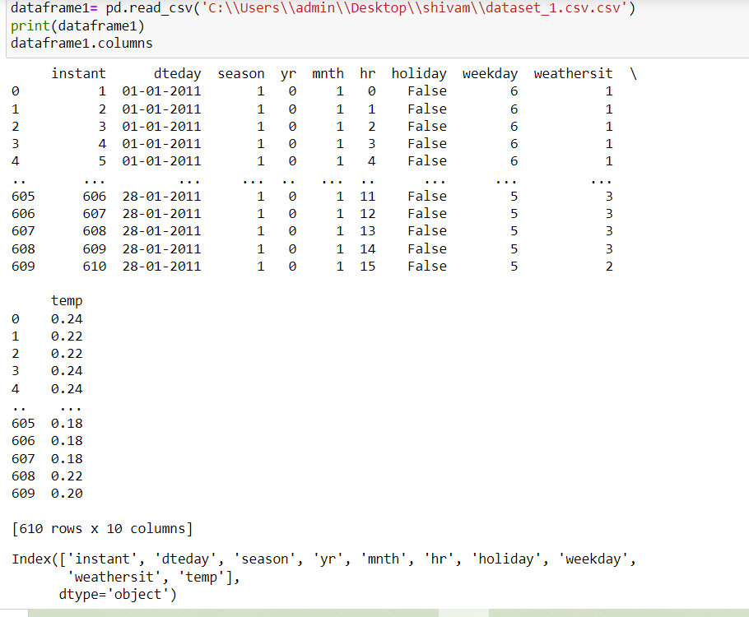
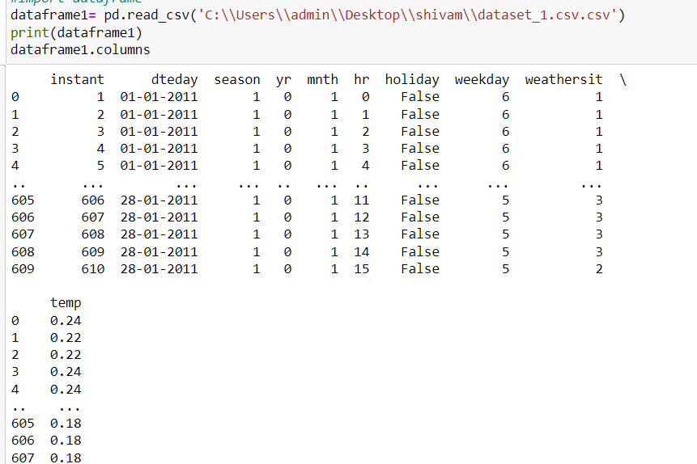
Step:1 Upload data Set-1

Slide 3
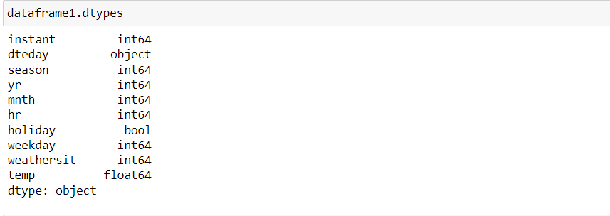
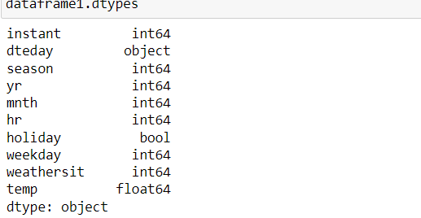
Step2:Check Datatype of the Dataset

Slide 4
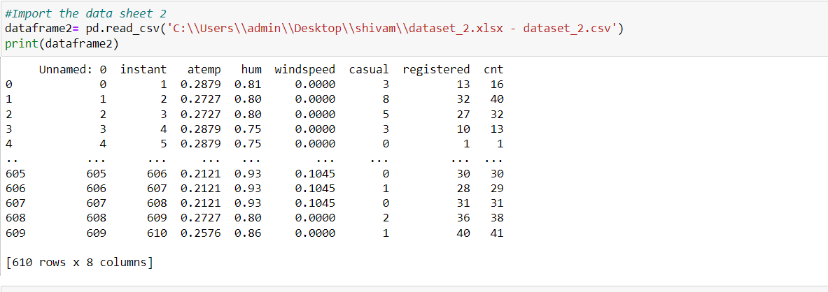
Step:3 Upload the Data set2

Slide 5
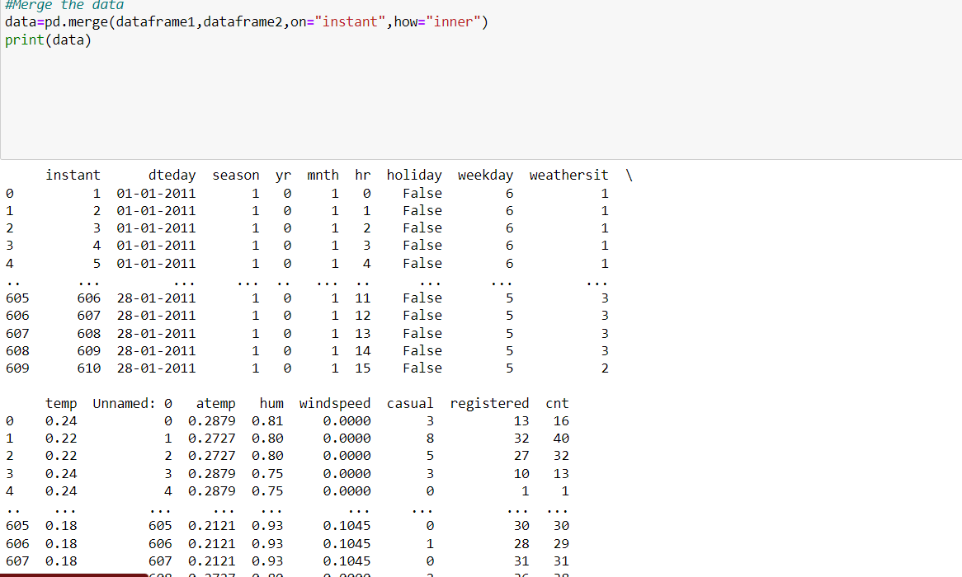
Step 4: Merge Data Set1 and Set2

Slide 6
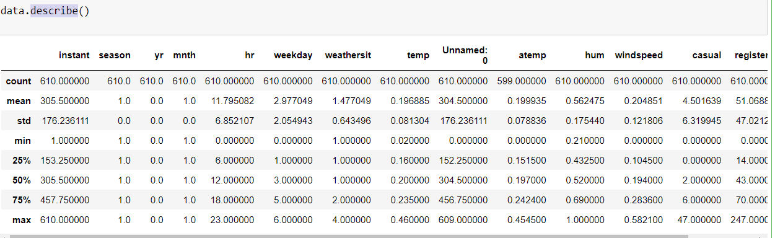
Step:5 Describe the Merge Data Set

Slide 7
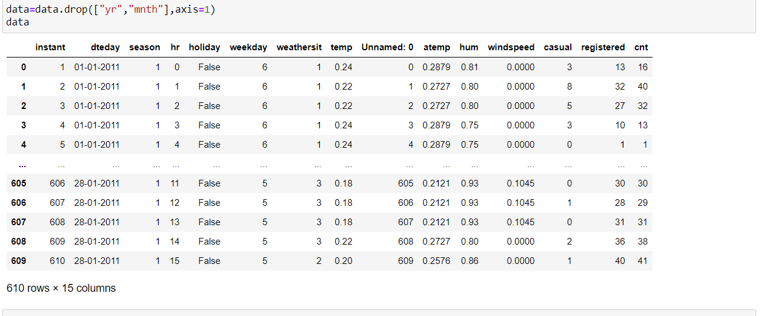
Step:6- Drop Unnecessary Columns

Slide 8
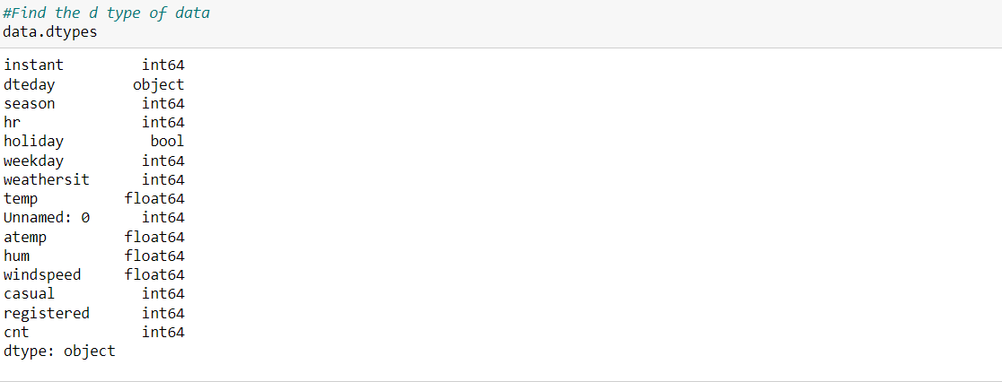
Step:7-Find the Data types in Merge Data Set

Slide 9
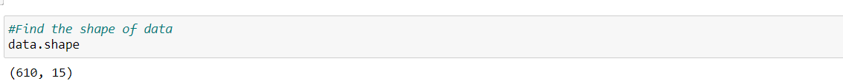
Step:8- Find the Shape of Merge Data

Slide 10
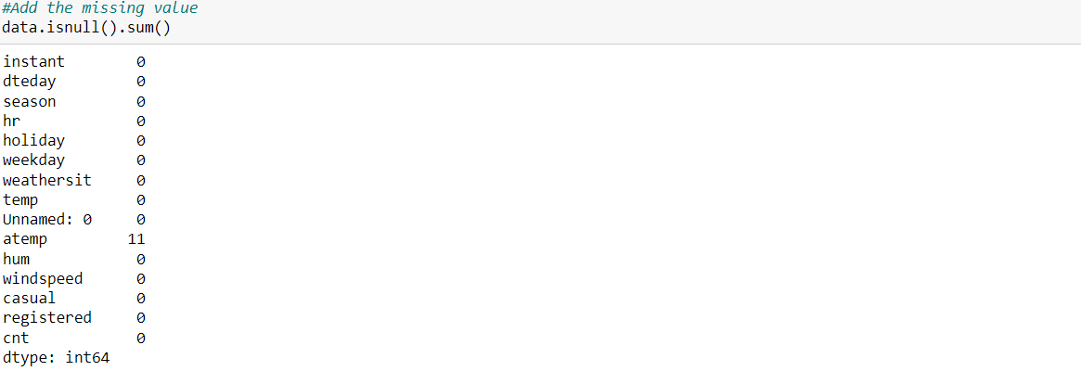
Step:9- Treat Missing Values

Slide 11
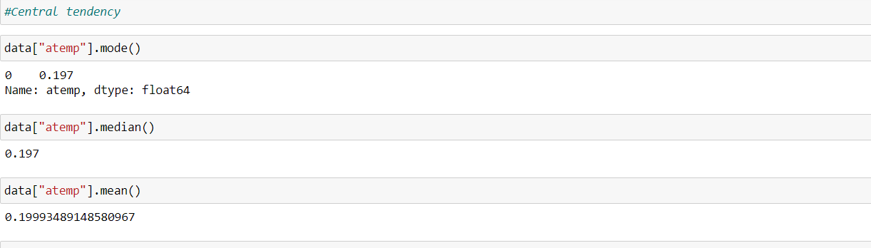
Step:10- Central Tendancy

Slide 12
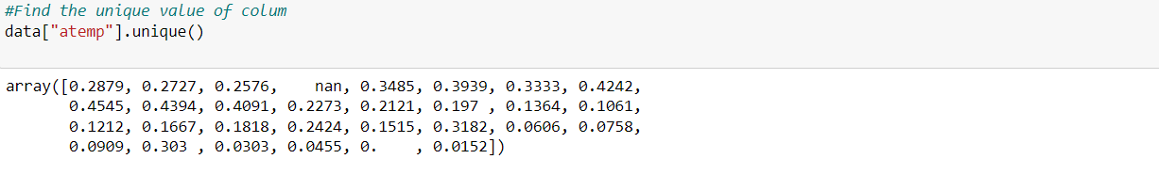
Step:11- Identify Unique Values

Slide 13
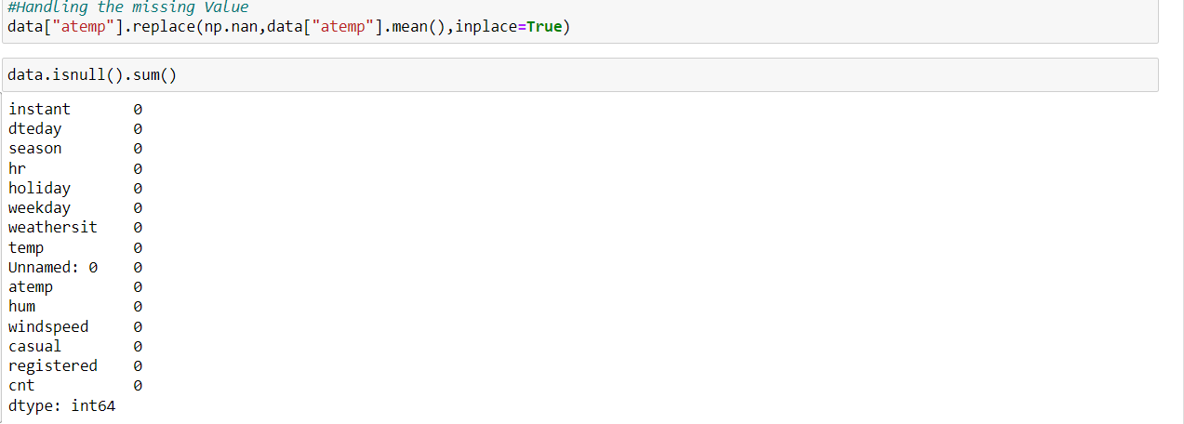
Step:12- Handling the Missing Value

Slide 14
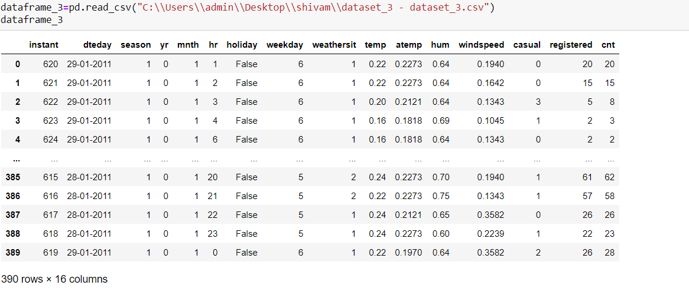
Step:13-Upload the Data Set3

Slide 15
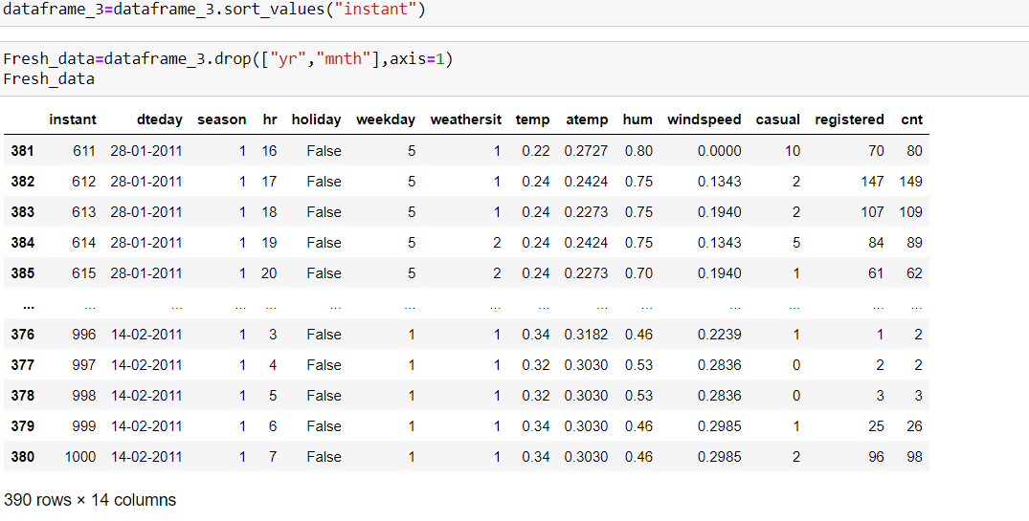
Step:14-Drop Unnecessary Columns and Sort Value(Note: In Instant Value Start From 620 So I sort it)

Slide 16
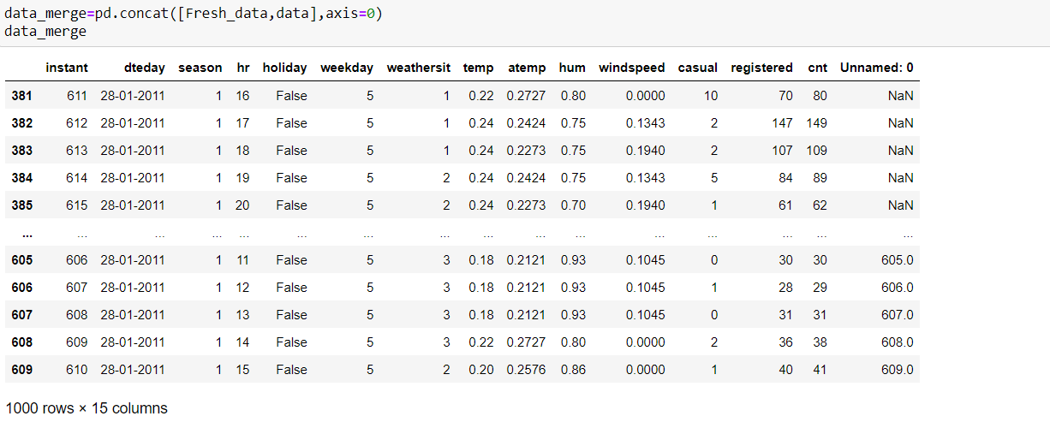
Step:15- Concatenate Combine Data

Slide 17
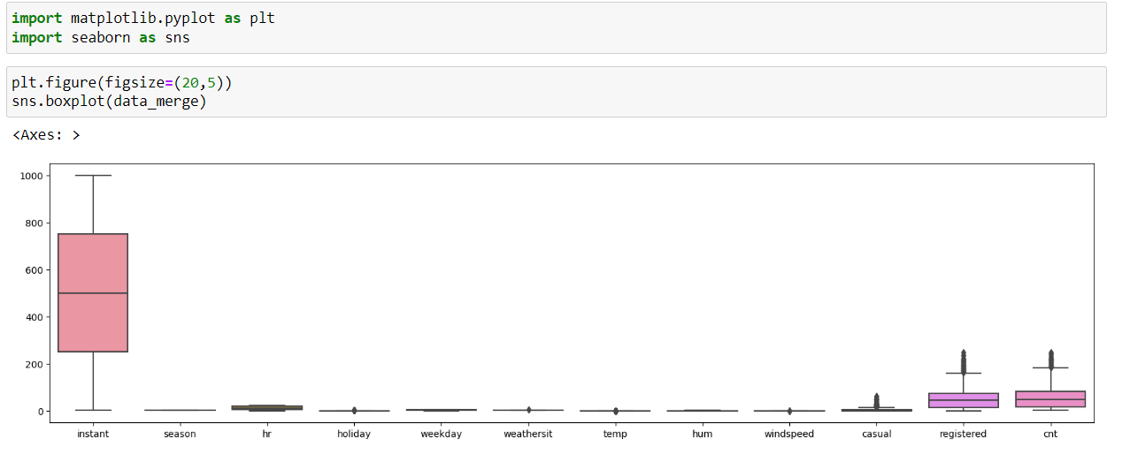
Step:16-Visualization and Handle Outliers

Slide 18
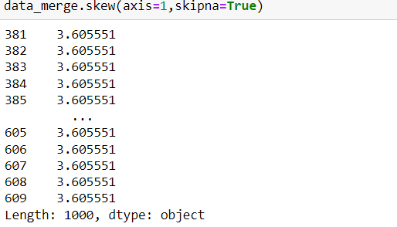
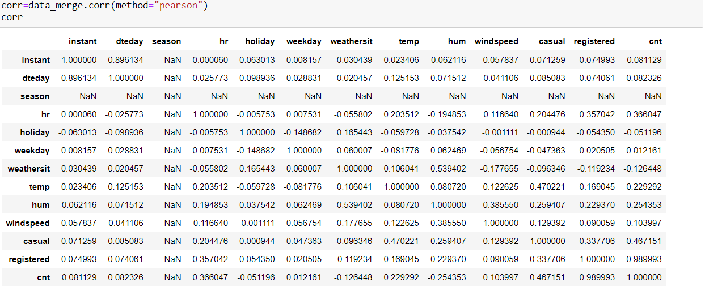
Step:17 Check Skewness and Correlation

Slide 19
Step:18-Conclusion
I work on Dirty Data set and Convert into Clean Data Set

Slide 20
THANK YOU

